Slide 1
Eigen values and Eigen vectors
Dr. Siva - Cognizant

Slide 2
Linear Algebra – A relook
Solution of linear system of equations.
Considering only square matrices
LU decomposition
Through echelon form, check whether equations have
An unique solution
Multiple solutions (infinite)
No solution.
Unique solution:
Echelon form consistent and no row with all zeros
System matrix is invertible
All columns(rows) linearly independent
Non zero determinant
Is of full rank.
No zero Eigen value
Multiple(infinite) solutions or no solution
Echelon form consistent and atleast one row with all zeros
No solution:
Echelon form, Last column has a pivot ( divide by zero)

Slide 3
What we looked at?
Vector spaces, Algebra, products, application of dot product, Projections, Orthogonal vectors and projections, Orthogonalization
Linear system of equations
Matrices, Matrix operations
Solution of linear equations of the form Ax = b.
LU decomposition – For the solution and to arrive at the form to get ideas on the solution
Echelon forms – Nature of the solution
Determinants and applications
Rank of a matrix
Eigen values and Eigen vectors
Applications

Slide 4
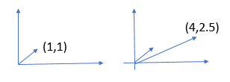
Introduction
What is Eigen?
Eigen essentially ‘characteristic’.
With each matrix, a set of characteristic values can be associated. Those are Eigen values.
A matrix multiplies a vector, it results in another transformed vector. This process can be interpreted as operation of a matrix on a vector.
A matrix transforms one vector into another.
In that process, two things are possible. i) Stretching(or contraction) and ii) rotation.
A = [1,3; 2,.5] ;
A vector (1,1) gets transformed into [4, 2.5]

Slide 5
Suppose, there are vectors such that multiplication by a given matrix results in the change in the magnitude of the vector but not direction(x) then we will have Ax representable by λx.
In that case, Ax = λx;
➔ A²x = λ²x ➔ A^{n}x = λ^{n}x .
This created a lot of interest in this direction.
The ‘λ’s which satisfy the equation Ax = λx are known as Eigen values and the vectors that satisfy for the given A and the obtained λ are known as Eigen vectors.

Slide 6
How to find out vectors satisfying Ax = λx
Let Ax = λx ;
It can be written as Ax = λIx where I is unit matrix.
( λI-A)x = 0;
The Eigen vectors (x) belong to the Null space of (λI-A).
If there is one vector (Eigen vector) in the Null space of a matrix, then the matrix is not of full rank.
From the theory of determinants , it can be shown that the matrices without full rank, have the determinant Zero.
If there are vectors for which the matrix does not change the direction, they can be found out by solving the above equation along with the corresponding values for ‘λ’.
Many questions arise.
How many such pairs of (λ, x ) are there and how to find them out?
The determinant expression gives us the answer. It results in the polynomial of order equal to the dimension of the matrix.
Are the Eigen vectors unique w.r.t.eigen value? May be or may not be!!!!!!!!!!!!!!
There are many results that ‘d be useful.

Slide 7
Determination of Eigen vector
Let A = [.8,.3;.2,.7]
Let Ax = λ I x ; x = [x1,x2]^{T.}
(λI-A)x = 0;
The Eigen vectors belong to the Null space of (λI-A).
If there is one vector (Eigen vector) in the Null space of a matrix, then
En matrix is not of full rank.
Then det(λI-A) = 0;
Using this relation, all ‘λ’s can be computed.
This equation is known as the ‘characteristic equation’ of the matrix A.
For the matrix A [.8,.3;.2,.7], we are given det(λI-A) =0;
.8 – λ .3
.2 .7-λ = 0;

Slide 8
➔(.8- λ)(.7- λ)-.06=0 ➔ λ² –(3/2) λ + (1/2)=0;
There are two values for λ. Let them be λ1, λ2
(λ- 1) (λ -.5) = 0
The corresponding Eigen vectors can be found out as
(A- λ1I) * xeigen1=0;
This expression can be expanded to give 2 independent equations to determine the Eigen vector xeigen1.
Let λ = 1, let I be the unity matrix ( a 2 dim matrix in which the element
(A – 1* I)xeigen1 = [0,0]^{T}

Slide 9
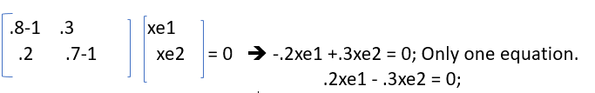

Eigen vector determination
The Eigen vector are given by
The vector (3,2)^{T} can also be considered as Eigen vector.
It can be seen that all these vectors fall in the same line (c, 2/3c) where c is any real number.
Eigen vectors essentially denote the direction and Eigen values the magnitude.

Slide 10
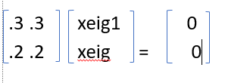
With the other value .5 we have
.3 .3 xeig1 0
.2 .2 xeig = 0
[1,-1] is an Eigen vector.
We have [.3,.2] and [1,-1] as Eigen vectors.

Slide 11


Analysis: Good news
Bad news:
The Eigen values need not be real.
Row column operations do not preserve the Eigen values. They do change.
Consider multiplication by a matrix
0 1 1 0 The Eigen values: λ² +1 = 0 ➔ λ= +i, -i where I is (-1)**(1/2)
-1 0 0 = -1
The matrix rotates the vector by -90 degrees. [ 1 0][0 -1]^{T} = 0; (Rotation corresponds to multiplication by ‘i’

Slide 12
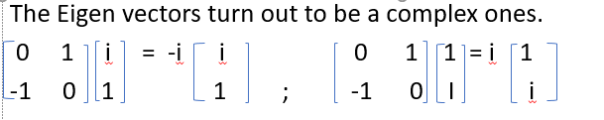

Eigen systems – Some more insights
Repeated Eigen values:
Consider the matrix
1 -1 The Eigen values are given by solving = 0;
1 -1
➔ λ² = 0 ➔ λ = 0,0
Point to be noted is that there is only one Eigen vector!!! ‘0’ does not matter!

Slide 13
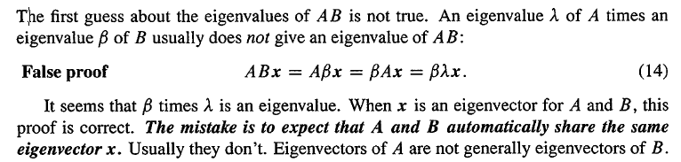
To be careful in Math

Slide 14
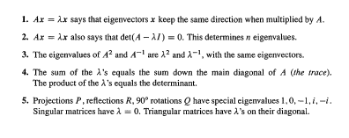
Summary

Slide 15
Symmetric positive definite matrices
Consider [ 2, 1; 1, 2];
Characteristic equation
2-λ 1
1 2-λ
(2-λ)(2-λ) -1=0 ➔ λ = 1,3
Eigen vectors:
2-1 1 xe1 ➔ xe1 + xe2 =0; (1,-1)
1 2-1 xe2
The other choice leads to –xe1+xe2=0; xe1 = xe2 ( 1,1)
Observation: Matrix is symmetric.
Eigen vectors are orthonormal. There we are!!!!

Slide 16
Eigen value decomposition
Eigen vectors satisfy
A e = λ e ; Here ‘e’ is the Eigen vector.
Suppose there are many Eigen values and vectors, we can write
A e1 = λ1 e1;
A e2 = λ2 e2;
A en = λn en;
Ae1, Ae2 are all column vectors. We can arrange them as
[Ae1 Ae2 … Aen ] = A [e1 e2 … en] = AE where E = [ e1 e2 … en];
Now [ λ1e1 λ2e2 …. λnen] = λ1e11 λ2e12 … λne1n
λ1e21 λ2e22 … λne2n
………..
λ1en1 λnen2 … λnenn

Slide 17
Eigen decomposition
e11 e12 … e1n λ1 0 0 0 0 0
e21 e22 … e2n 0 λ2 0 0 0 0
………..
en1 en2 … enn 0 ………. λn
= e11λ1 e12λ2 ………..e1n λn
e21λ1 e22λ2 ………..e2nλn
……..
en1λ1……………..
= E Λ where Λ is diag(λ1, λ2,….. λn)
Now

Slide 18
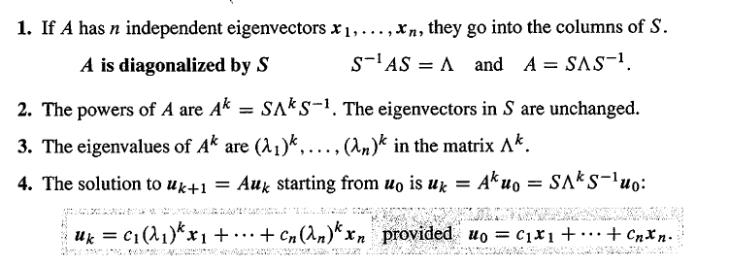
➔ AE = E Λ.
A = E Λ E⁻¹

Slide 19
Now what is the use of the above diagonalization?
It is known that Ax = λx; A^{n} x = λ^{n} x;
Using the same arguments given below, we will have
A^{n} E = Λ^{n} E;
A^{n} = E⁻¹ Λ^{n} E;
Λ^{n} = Diag (λ1^{n} , λ2^{n} ,…, λn^{n} )
The above expression essentially gives a way for computing A^{n} just by evaluating λ1^{n} , λ2^{n} ,…, λn^{n} .

Slide 20
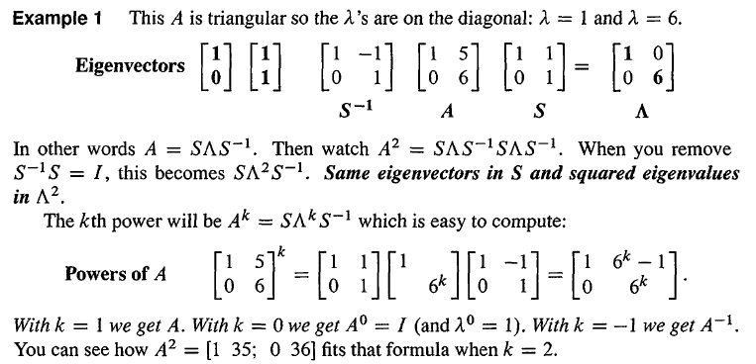

Slide 21
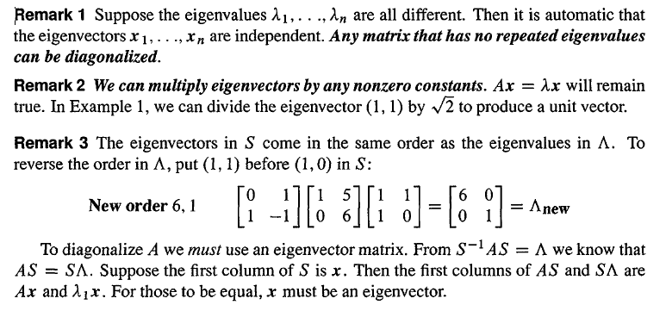

Slide 22
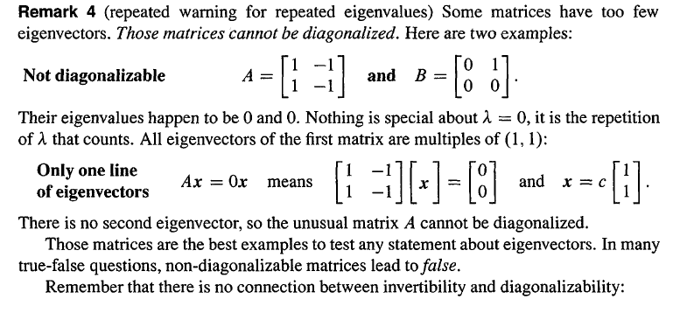

Slide 23
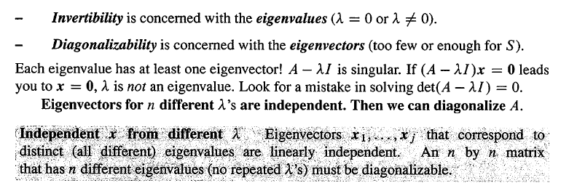

Slide 24
Symmetric matrix
If A= A^{T} then A is defined to be symmetric matrix.
What is so special?
The inverse is also symmetric
(A⁻¹ )^{T} = (A^{T} )⁻¹ = A⁻¹
Let A = A^{T}
The diagonalization of A leads to
A = S Λ S⁻¹
A^{T} = ( S⁻¹ )^{T} Λ S^{T}
Now A = A^{T} ; This could imply (S⁻¹ )^{T} = S ➔ S⁻¹ = S^{T}
S^{T} S = I ➔ the dot products of rows and columns of left and right matrices, if not equal is Zero.
➔ The columns are orthogonal in other words the Eigen vectors.

Slide 25
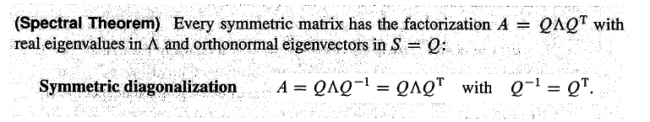
Spectral theorem
Harder to prove that the Eigen values of a symmetric matrix are real.
Proof: Suppose there are complex roots. X will also be complex vector. Then xbar = complex conjucate (x) is also a complex number.
Ax = λx ➔ A xbar = λbar . xbar; Transpose to (xbar)^{T} A = (xbar)^{T} λbar
xbar^{T} Ax = xbar^{T} λx and (xbar)^{T} Ax = (xbar)^{T} λbar x ➔ λ = λbar ➔ λ are real.

Slide 26
Vector and matrix norms
We talked of distance or metric among abstract objects.
The conditions to be satisfied are
i) Distance from itself is 0. ii) Distance between (A,B) = dist(B,A) iii)Triangle law: Distance between (A,B) <= dist(A,C) + dist(C,B).
When we introduced algebra there came the concept of origin(0 element).
The norm of a vector is basically the magnitude or the size.
It is the metric between 0 element and the object (vector coordinates.)
In linear spaces, the norm of vectors can be
Let a = xi +yj +zk
Then ||a|| = Sqrt( x**2 +y**2 + z**2). This is known as Euclidian norm.

Slide 27
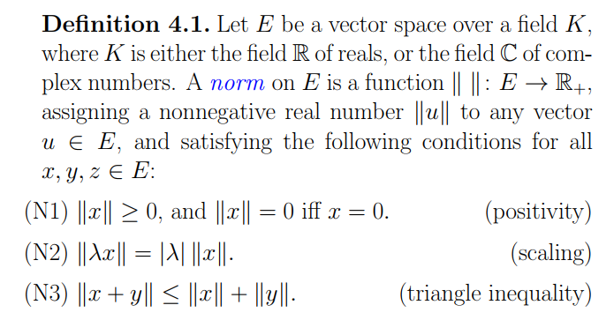
Formal definition of a norm (http://www.cis.upenn.edu/~cis515/cis515-11-sl4.pdf)

Slide 28
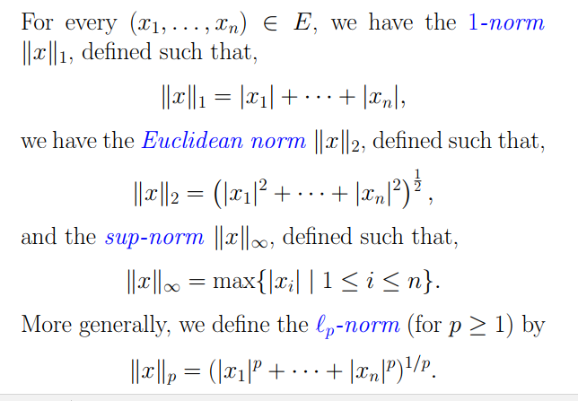
|x|+|y|

Slide 29
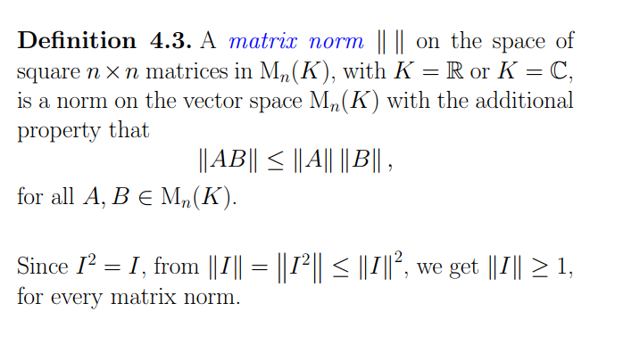
Matrix norms
IN the mean time the absolute value of the largest Eigen value of a given square matrix is called spectral radius. The set of Eigen values are called ‘spectrum’ of the matrix.

Slide 30
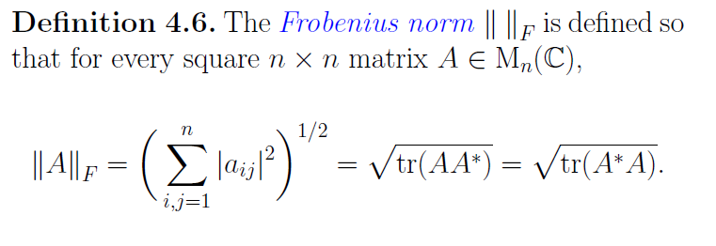
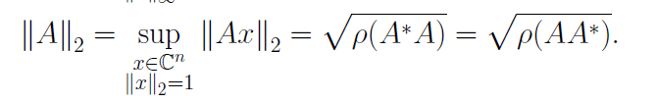
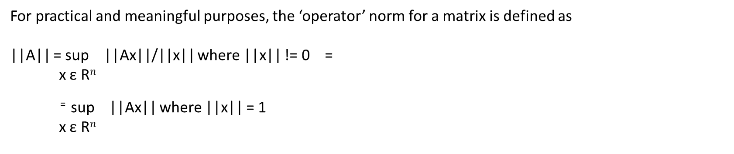
Matrix norm
For practical and meaningful purposes, the ‘operator’ norm for a matrix is defined as
||A|| = sup ||Ax||/||x|| where ||x|| != 0 =
x ε R$n$
⁼ sup ||Ax|| where ||x|| = 1
x ε R$n$

Slide 31
Case study – Principal component analysis
Principal component analysis:
Principal component analysis (PCA) is a statistical procedure that uses an orthogonal transformation to convert a set of observations of possibly correlated variables into a set of values of linearly uncorrelated variables called principal components (or sometimes, principal modes of variation).
It is a way of identifying patterns in data, and expressing the data in such a way as to highlight their similarities and differences.
Since patterns in data can be hard to find in data of high dimension, where the luxury of graphical representation is not available, PCA is a powerful tool for analyzing data.

Slide 32
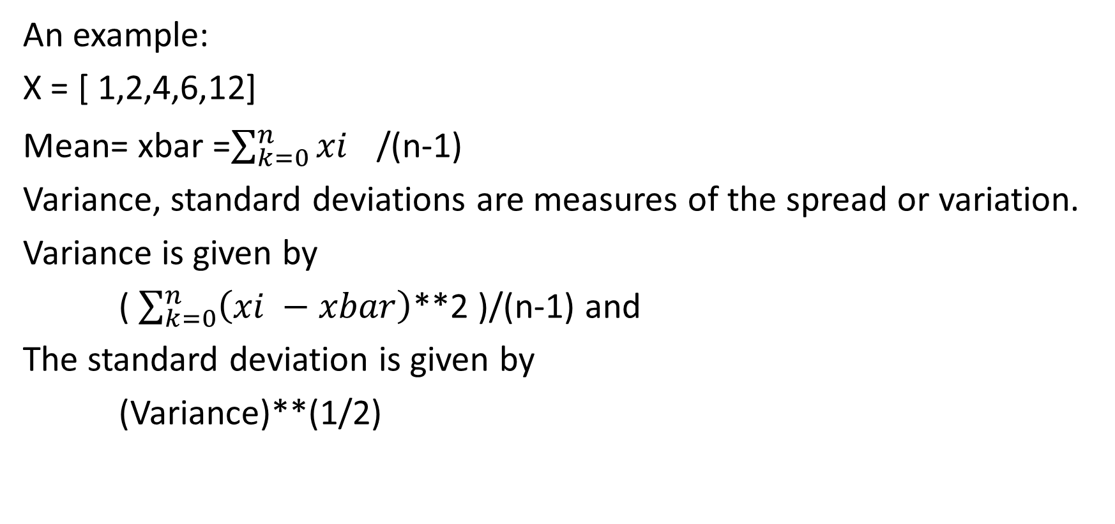
Basic statistical terms
An example:
X = [ 1,2,4,6,12]
Mean= xbar =$\sum_{k=0}^{n}{{xi}^{}}$/(n-1)
Variance, standard deviations are measures of the spread or variation.
Variance is given by
( $\sum_{k=0}^{n}{\left(xi −xbar\right)}$**2 )/(n-1) and
The standard deviation is given by
(Variance)**(1/2)

Slide 33
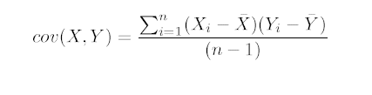
Covariance
In practice the data would consist of many vectors such as heights of students, marks etc., etc.,
The question is to find out how related they are.
The relationship may be, if one data element increases whether the other increases or decreases or no relationship at all.
A measure ‘Covariance’ is defined between 2 data elements or two features or two dimensions as a measure which is
Variance is nothing but covariance between the same dimension or feature.

Slide 34
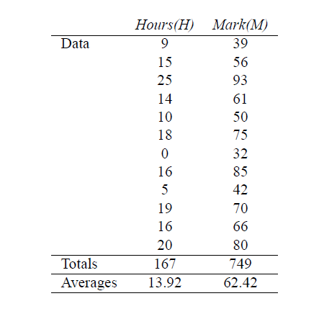
Example

Slide 35
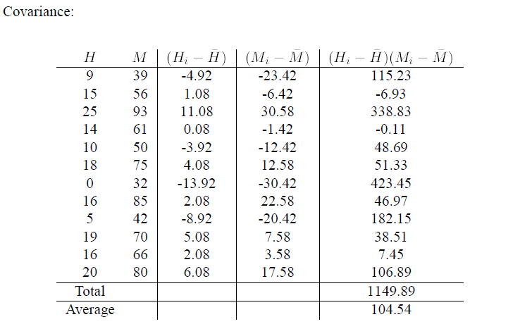
Computations

Slide 36
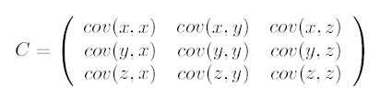
In case of multiple features we will have covariance matrix
PCA is explained with a simple 2 dim.
Idea: If a data set have 100 features.(height, weight, blood pressure(systolic), diastolic, temperature etc., etc.,). This means we have many data elements xi i=1,2,….100 to be considered for some pattern recognition.
However, some of these data elements may be related to each other hence there can be redundancies.
Ideally we have to arrive at a set of data elements (as a function of the present data elements) which are independent of each other. That’d give as much information as required for the purpose.
The independence between any two features is characterized by low covariance.
Since we are considering only the ‘variation’, the constant components from the data are to be removed from the data elements.

Slide 37
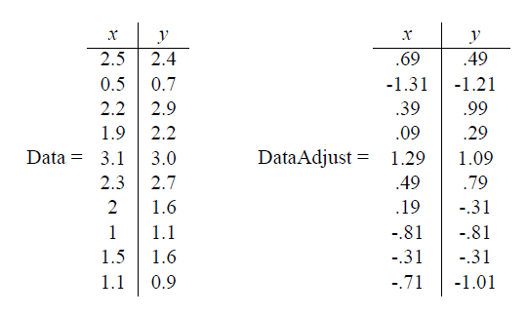
Suppose we have two data elements as shown in the following.
Consider x and y. Subtract the mean of x and y from the respective data give adjusted x and y.

Slide 38
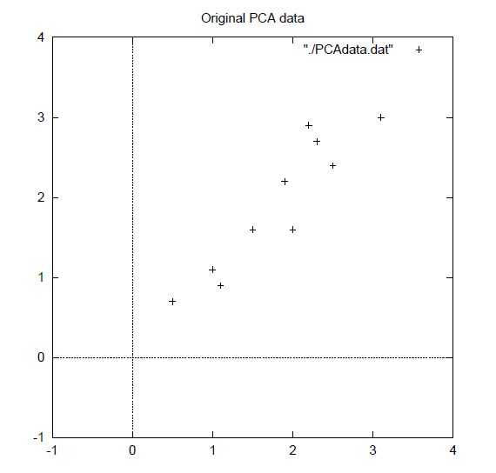

Slide 39
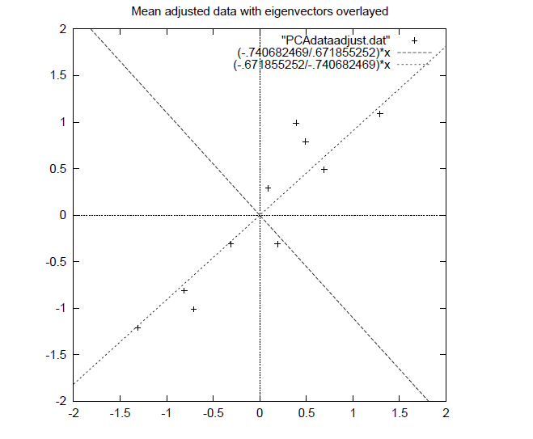
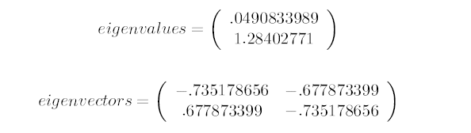
The covariance matrix is symmetric (infact positive definite). Hence the singular values are Eigen values. The Eigen vectors are orthogonal.
Arrange the Eigen values in the descending order. The Eigen vectors corresponding to the leading Eigen values give the direction of dominant feature vectors.
Eigen vector corresponding to the highest Eigen value is the principal component.
The feature vector are the dominant ones corresponding to the higher Eigen values.

Slide 40
Knowing the dominant ‘Eigen vectors’ , the idea is that all the feature vectors are to be projected along these Eigen vectors .
This means that the dot products are to be taken between the original feature vector and the selected Eigen vector after normalizing the Eigen vectors.
Thus each sample can be represented by one single number instead of 2.
The final output is a vector containing one point for one data vector.
In conclusion, if there are 100 features in a data set containing 1000 vectors, we will have covariance matrix of dimension 100x100.If we select 50 Eigen vectors correspond to first 50 Eigen values, the original 1000 vectors can be decomposed along the first 50 Eigen vectors with residual.
Thus the new data set would contain 1000 records with 50 new features.
Machine learning algorithm can be performed on these.
The old feature values could be extracted from new feature vectors by simple linear transformations.

Slide 41
In regression problems, we have tuples of observations which are the values of features or attributes or dimensions and the respective classes.
The observations are
( x11, x12, …,x1n) and the label y1 ( w1x11+w2x12+w3x13+…+wn x1n= y1)
(x21,x22,…,x2n) and the label y2. ➔ X W = Y ( X need not be a square matrix)
For getting the correct values of W, it is necessary to have
The features are independent of each other.
The values of feature should have large variations.
These two conditions would give better numerical stability and accuracy.
The features with lower variations will not have much effect on the class the output belongs to.

Slide 42
These ideas give rise to the following.
Consider the covariance matrix
Based on the ideas given, it is better if the covariance matrix is diagonal and diagonal values are as high as possible.
That could be done by the process called ‘diagonalization’ of the covariance matrix. The ‘Eigen vectors’ essentially give the direction about which the variations can be characterized and the corresponding Eigen values give the magnitude.(variance of the component in the direction of the Eigen vector.)

Slide 43


Singular values and vectors
Eigen values essentially they are characteristic numbers of a square matrix.
A similar characterization is required for non square matrices as they also map the vectors from one vector space to another ofcourse of different dimensions.
In that case, the norms like Frobenious norm can be considered.
For practical purposes, the induced norm such as
Definition: The largest Eigen value (absolute value) is known as ‘Spectral radius’ of a square matrix. However, the spectral radius directly does n’t satisfy the properties of a norm.
Spectral radius of a given square matrix M is given by

Slide 44


Induced norm
Now
Outline of the proof:
ρ(A A*) = λ1 where the Eigen values are λ1 >,….λ(n-1), λn..
Then,
Also if A is Hermitian(A= A^{T}) , if λ1 ,…., λn are the Eigen values of (A A* ) they are nothing but μ1², μ2²,…, μn² , where μ1, μ2,…, μn are the Eigen values of A.

Slide 45
Application of singular value decomposition

